Slide 1
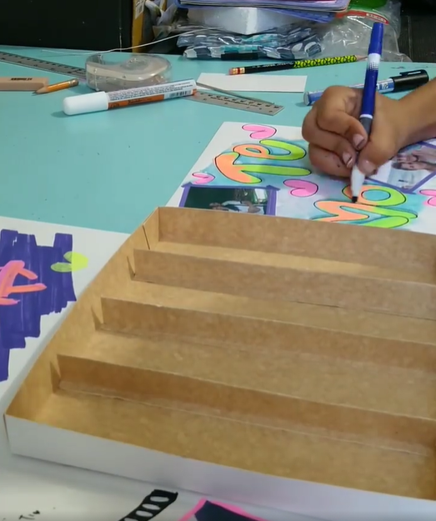


Slide 2


Sales System LIROZ

